Slide 1

Optimize and save your IT costs

Slide 2

How can we reduce AWS services costs
Choose the right pricing models.
Match capacity with demand.
Implement processes to identify resource waste.

Slide 3
Choose the right pricing models
Use Compute Savings Plans to reduce EC2, Fargate and Lambda costs Savings Plans is a flexible pricing model that provides savings of up to 72% on your AWS compute usage. This pricing model offers lower prices on Amazon EC2 instances usage, regardless of instance family, size, OS, tenancy or AWS Region, and also applies to AWS Fargate and AWS Lambda usage. Use the recommendations provided in AWS Cost Explorer, and ensure that you have chosen compute, one year, no upfront options. Once you sign up
Use Amazon EC2 Spot Instances to reduce EC2 costs Customers can use Spot Instances to receive up to a 90% discount off On-Demand prices without making a term-based commitment. Spot instances are an ideal option for applications that are fault-tolerant, scalable, or flexible, such as big data (EMR, Hadoop, Spark clusters), containerized workloads (ECS/EKS or self-managed Kubernetes), CI/CD, web servers, high performance computing (Batch, grid servers, genomic sequencing) and test & development en
Use Reserved Instances (RI) to reduce RDS, Redshift, ElastiCache and Elasticsearch costs For certain services like Amazon EC2 and Amazon RDS, you can invest in reserved capacity. With Reserved Instances, you can save up to 72% over equivalent on-demand capacity. Reserved Instances are available in 3 options – All up-front (AURI), partial up-front (PURI) or no upfront payments (NURI). Use the recommendations provided in AWS Cost Explorer RI purchase recommendations, which is based on your RDS, R

Slide 4
Match capacity with demand
Analyze Amazon DynamoDB usage and reduce cost by leveraging Autoscaling or On-demand Analyze your DynamoDB usage by monitoring 2 metrics, ConsumedReadCapacityUnits and ConsumedWriteCapacityUnits, in CloudWatch. To automatically scale (in and out) your DynamoDB table, use the AutoScaling feature. Using the steps here, you can enable AutoScaling on your existing tables. Alternately, you can also use the on-demand option. This option allows you to pay-per-request for read and write requests so that you only pay for what you use, making it easy to balance costs and performance.
Identify Amazon EC2 instances with low-utilization and reduce cost by stopping or rightsizing Use AWS Cost Explorer Resource Optimization to get a report of EC2 instances that are either idle or have low utilization. You can reduce costs by either stopping or downsizing these instances. Use AWS Instance Scheduler to automatically stop instances. Use AWS Operations Conductor to automatically resize the EC2 instances (based on the recommendations report from Cost Explorer).
Identify Amazon RDS, Amazon Redshift instances with low utilization and reduce cost by stopping (RDS) and pausing (Redshift) Use the Trusted Advisor Amazon RDS Idle DB instances check, to identify DB instances which have not had any connection over the last 7 days. To reduce costs, stop these DB instances using the automation steps described in this blog post. For Redshift, use the Trusted Advisor Underutilized Redshift clusters check, to identify clusters which have had no connections for the last 7 days, and less than 5% cluster wide average CPU utilization for 99% of the last 7 days. To reduce costs, pause these clusters using the steps in this blog.

Slide 5
Implement processes to identify resource waste
Identify Amazon EBS volumes with low-utilization and reduce cost by snapshotting then deleting them EBS volumes that have very low activity (less than 1 IOPS per day) over a period of 7 days indicate that they are probably not in use. Identify these volumes using the Trusted Advisor Underutilized Amazon EBS Volumes Check. To reduce costs, first snapshot the volume (in case you need it later), then delete these volumes. You can automate the creation of snapshots using the Amazon Data Lifecycle Manager. Follow the steps here to delete EBS volumes. Analyze Amazon S3 usage and reduce cost by leveraging lower cost storage tiers
Use S3 Analytics to analyze storage access patterns on the object data set for 30 days or longer. It makes recommendations on where you can leverage S3 Infrequently Accessed (S3 IA) to reduce costs. You can automate moving these objects into lower cost storage tier using Life Cycle Policies. Alternately, you can also use S3 Intelligent-Tiering, which automatically analyzes and moves your objects to the appropriate storage tier. Review networking and reduce costs by deleting idle load balancers
Use the Trusted Advisor Idle Load Balancers check to get a report of load balancers that have RequestCount of less than 100 over the past 7 days. Then, use the steps here, to delete these load balancers to reduce costs. Additionally, use the steps provided in this blog, review your data transfer costs using Cost Explorer.

Slide 6
Use self-managed AWS services to control costs
AWS Cost Explorer
The Pricing Calculator
Econmics Resources Center
Creating a billing alarm to monitor your estimated AWS charges

Slide 7

Reduce time to market with CI/CD & Release Automation

Slide 8
CONTINUOUS DELIVERY IMPLICATIONS
Reduce feedback loop with stakeholders
More time adding real value and Less time configuring infrastructure
Reduce costs detecting errors earlier
Increase revenue with faster and more frequent production deployments
Protect revenue with automated tests
Avoid responsibility silos with Continuous Delivery

Slide 9
KEY PERFORMANCE INDICATORS
 | Currently | With Continuous Delivery
Lead time to production | 2 days | 2 hours
Rollback rate | 6 out of 13 executions | 2 out of 10 executions
Time to failure | 4 days | 10 minutes
Production uptime | 3 hours | 14 minutes

Slide 10
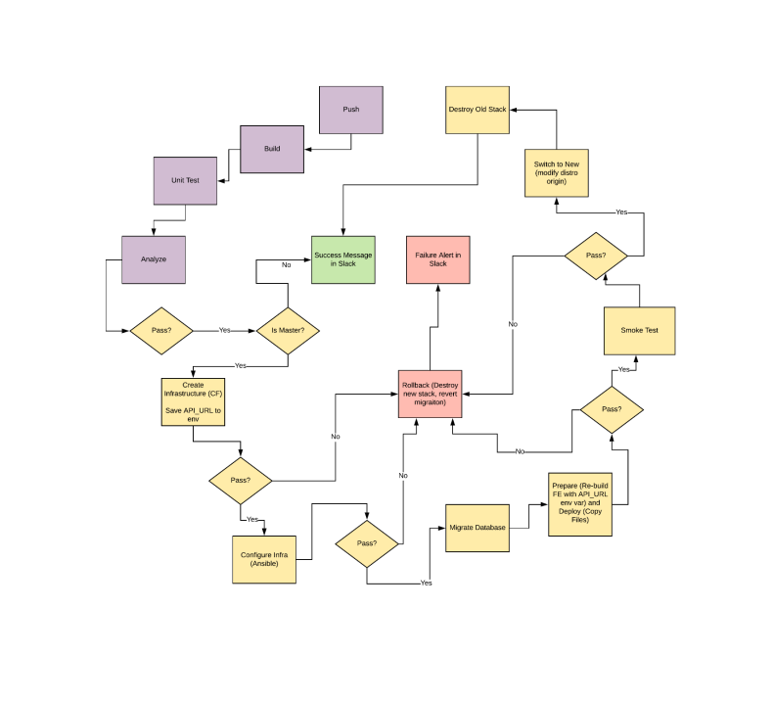
Current Manual Process Diagram

Slide 11
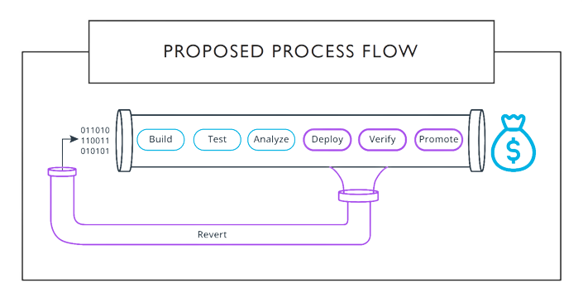
PROPOSED PROCESS FLOW

